Slide 1
Machine Learning
Lecture 1

Slide 2
Generalizing from examples
The objects that an algorithm will make predictions about are ‘examples’.
Generalization is the ability of a learning machine to perform accurately on new,unseen examples having experienced a learning data set.

Slide 3
Automatically learn programs from data
Instead of writing programs and testing data against the programs, Machine learning systems automatically write programs from the data.
In doing so, new programs need not be written every time any unexpected data arrives.

Slide 4
Applications
Web Search
Spam filters
Recommender Systems
Ad Placement
Credit Scoring
Fraud Detection
Stock Trading
Drug Design

Slide 5
Classification
Classification is the problem of identifying to which set of categories a new observation belongs on the basis of training set.
It is considered to be an instance of supervised learning.
An algorithm that implements classification is known as a Classifier.
A Classifier is a system that inputs (typically) a vector of discrete and/or continuous feature values and outputs a single discrete value, the class.

Slide 6
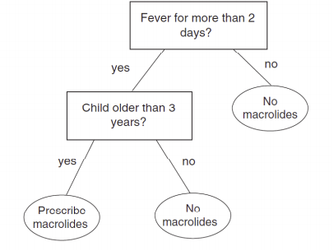
Decision Trees
The decision tree is a classic and natural model of learning. It is closely related to the notion “divide and conquer.”
The decision tree is so-called because we can write our set of questions and guesses in a tree format.
The goal in learning is to figure out what questions to ask, in what order to ask them, and what answer to predict once you have asked enough questions.

Slide 7
Naïve Bayes
Assumes that the presence (or absence) of a particular feauture of a class is unrelated to presence (or absence) of any other feature.
- Example:
A fruit may be considered an apple if it is red, round and about 4” in diameter.
Even if these features depend on each other or upon the existance of other features, a naive bayes classifier considers all of these properties to independently contribute to probability that this fruit is an apple.

Slide 8
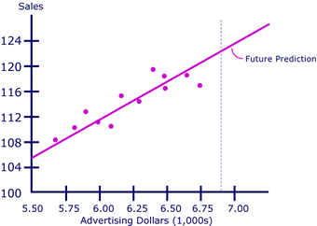
Linear Regression
Linear regression is an approach for modeling the relationship between a scalar dependent variable (Sales) and one or more independent variables denoted as (Advertising Dollars).
The case of one explanatory variable is called simple linear regression.

Slide 9
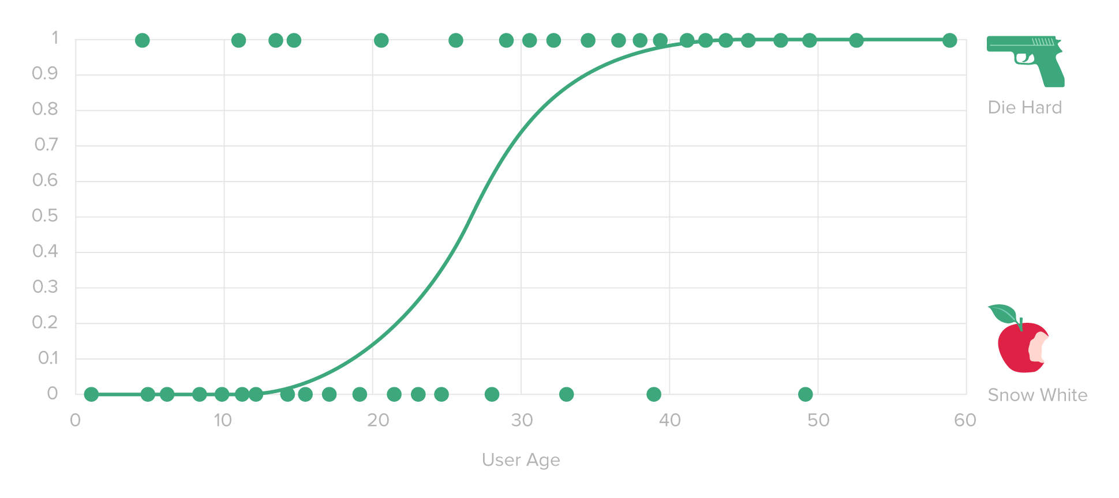
Logistic Regression
Logistic regression is used for analyzing a dataset in which there are one or more independent variables that determine the outcome.
There are only two possible outcomes in Logistic regression model.

Slide 10
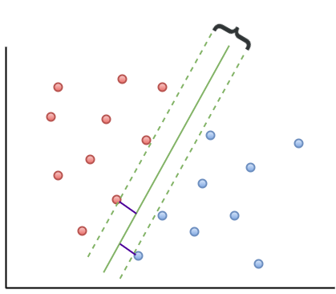
Support Vector Machine
A supervised learning model with associated learning algorithms that analize data and recognize patterns.
An SVM model maps examples as points in space seperated as per category by a clear gap that is as wide as possible.
New examples are then mapped into that same space and predicted to belong to a category based on where they lie.

Slide 11
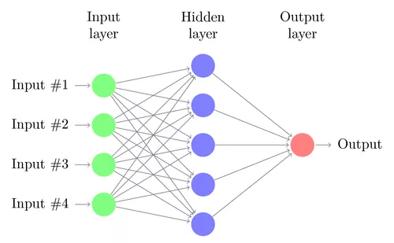
Neural Network
Neural Networks are computing systems inspired by the biological neural networks. Such systems learn to do tasks by considering examples, generally without task-specific programming.
An ANN is based on a collection of connected units called artificial neurons, Typically, neurons are organized in layers. Different layers may perform different kinds of transformations on their inputs.

Slide 12
Kernel Method
kernel methods are a class of algorithms for pattern analysis.
The general task of pattern analysis is to find and study general types of relations (for example clusters, rankings, principal components, correlations, classifications) in datasets.
A kernel function measures the similarity between two data points.

Slide 13
Clustering
The aim of Clustering is to segregate groups with similar traits and assign them into clusters.
Most used clustering algorithms are:
K-means
Fuzzy C-means
Hierarchical clustering
Mixture of Gaussians

Slide 14
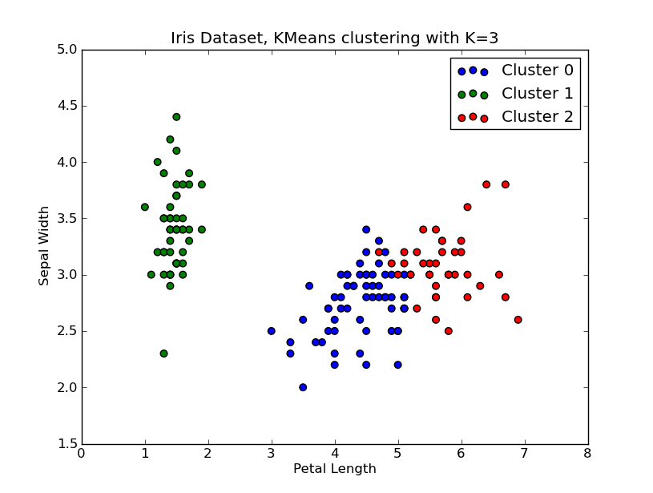
K-Means
The goal of this algorithm is to find groups in the data, with the number of groups represented by the variable K.
The algorithm works iteratively to assign each data point to one of K groups based on the features that are provided.

Slide 15
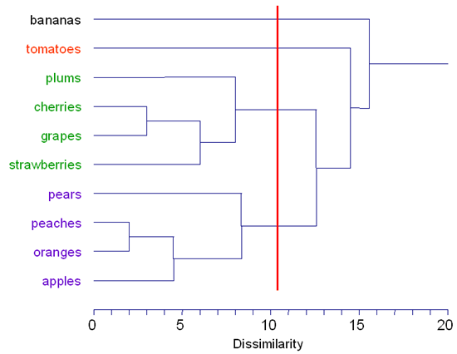
Hierarchical Clustering
Produces a set of nested clusters organized as a hierarchical tree
Can be visualized as ‘dendogram’(A tree like diagram that records the sequences of merges or splits).

